Slide 1
MAXIMIZE NETWORKS

Slide 2
What?
IEEE 802.3bt Power Over Ethernet:
Ratified in 2018
AKA - UPOE, UPOE+, POE++, 4PairPoE
Types:
Type 3 - Typically Pre-standard - 60 watt - Dual Signature
Type 4 - Standard - 90 watts - Single Signature
Run on CAT6 or specialty CAT 5e
There is designed losson the cable, so don't expect full power at devices, ie 90 watts at PoE switch is 72 watts at the device.

Slide 3
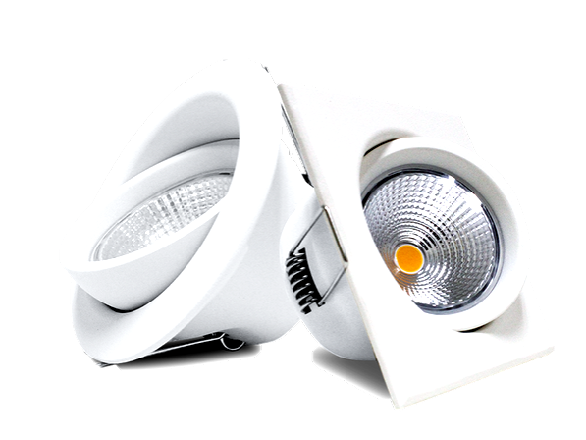
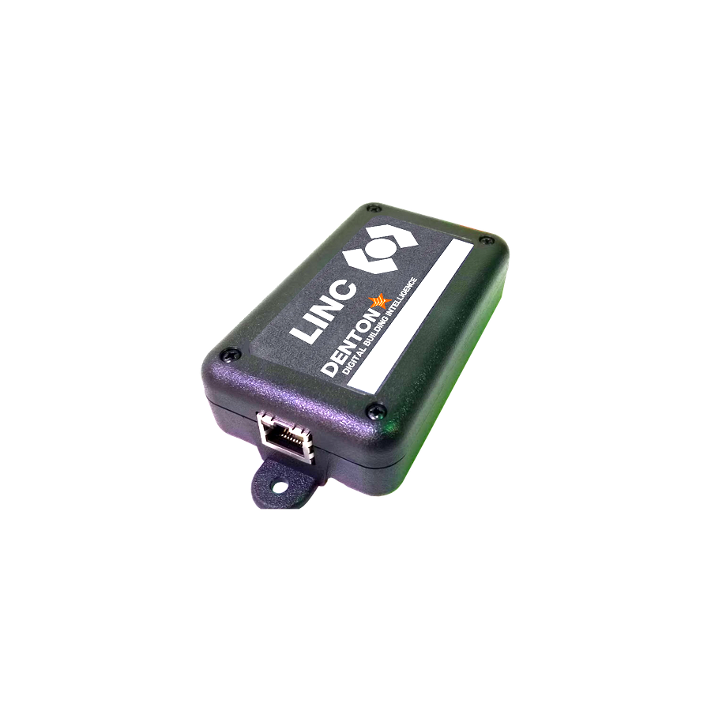
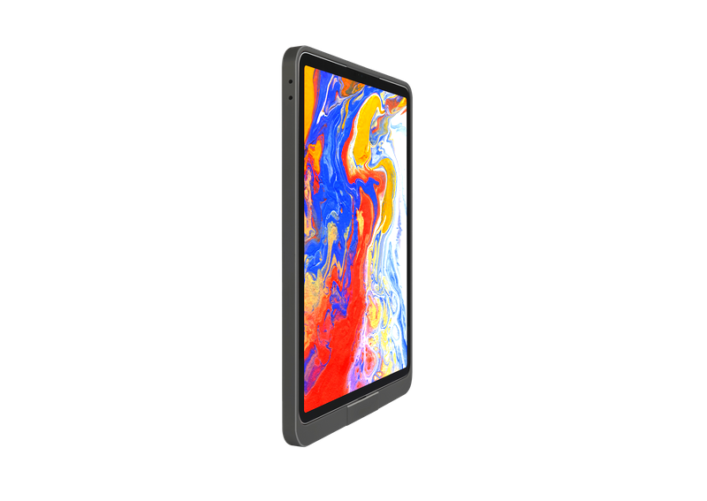
Why?
Power over Ethernet
36
Month RoI
30%
CAPEX Savings
>20%
OPEX Savings

Slide 4
Move Processing to the Edge
How?
Power More Powerful Devices
Integrate Modern Technology
Cool Stuff

Slide 5
USB-C
The Universal Standard
Apple, Google, Microsoft, and everyone agree on something
Power Delivery - 100 watts
Role Swapping and data transfer
Limitations of USB-C - Cost, run length

Slide 6
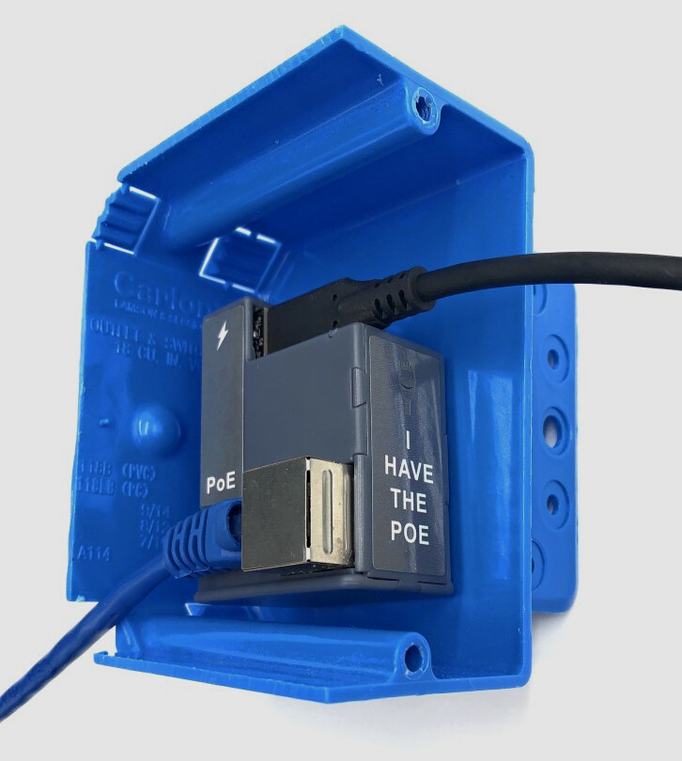
PUC - In-Wall PoE Conversion
IEEE 802.3at - 25 watts
Charging Only Port
Power and Data Port
95 Mbps Thru Put
Fits US and EU wall boxes
Range of USB-C to USB-C
and USB-C to Lightning Cables
AT-USBC-JB
Launched in 2021

Slide 7
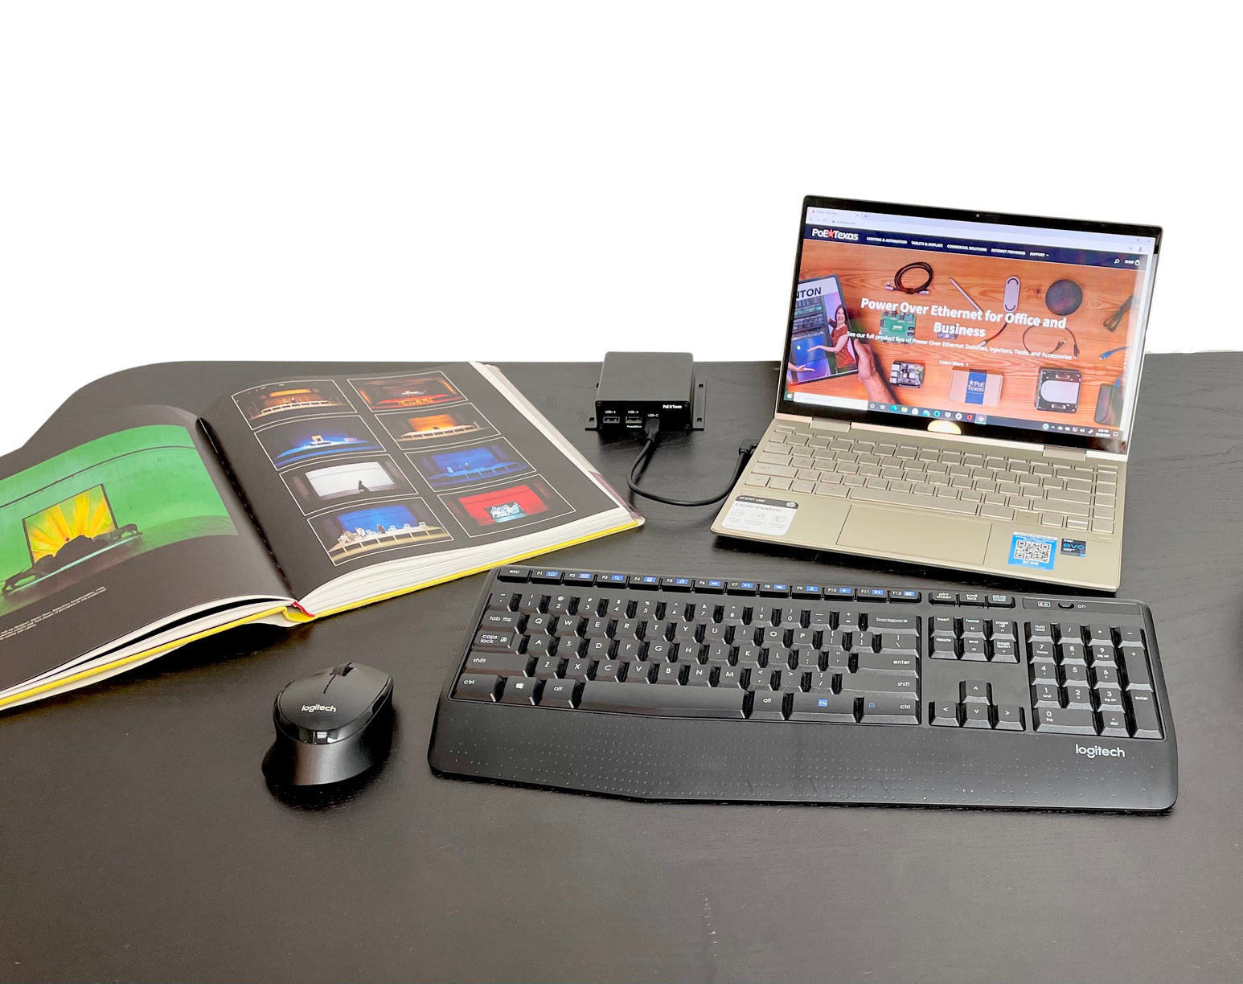
PUC-DOCK
USB-C Desk Mounted Dock
IEEE 802.3bt - 72 watts
Power and Data Port - Type C
2x USB-A Ports
95 Mbps Thru Put
Sturdy Metal Enclosure
Designed for Enterprise and Education
BT-USBC-A-PD
Piloting Now

Slide 8
USB In-Wall over PoE
IEEE 802.3at - 25 watts
Charging Only Dual Orientation Port
IEEE 802.3af PoE Port
Gigabit Mbps Thru Put
Fits US wall boxes
Affordably Transform Network Jacks
GAT-USB-IW
Launched in 2020

Slide 9
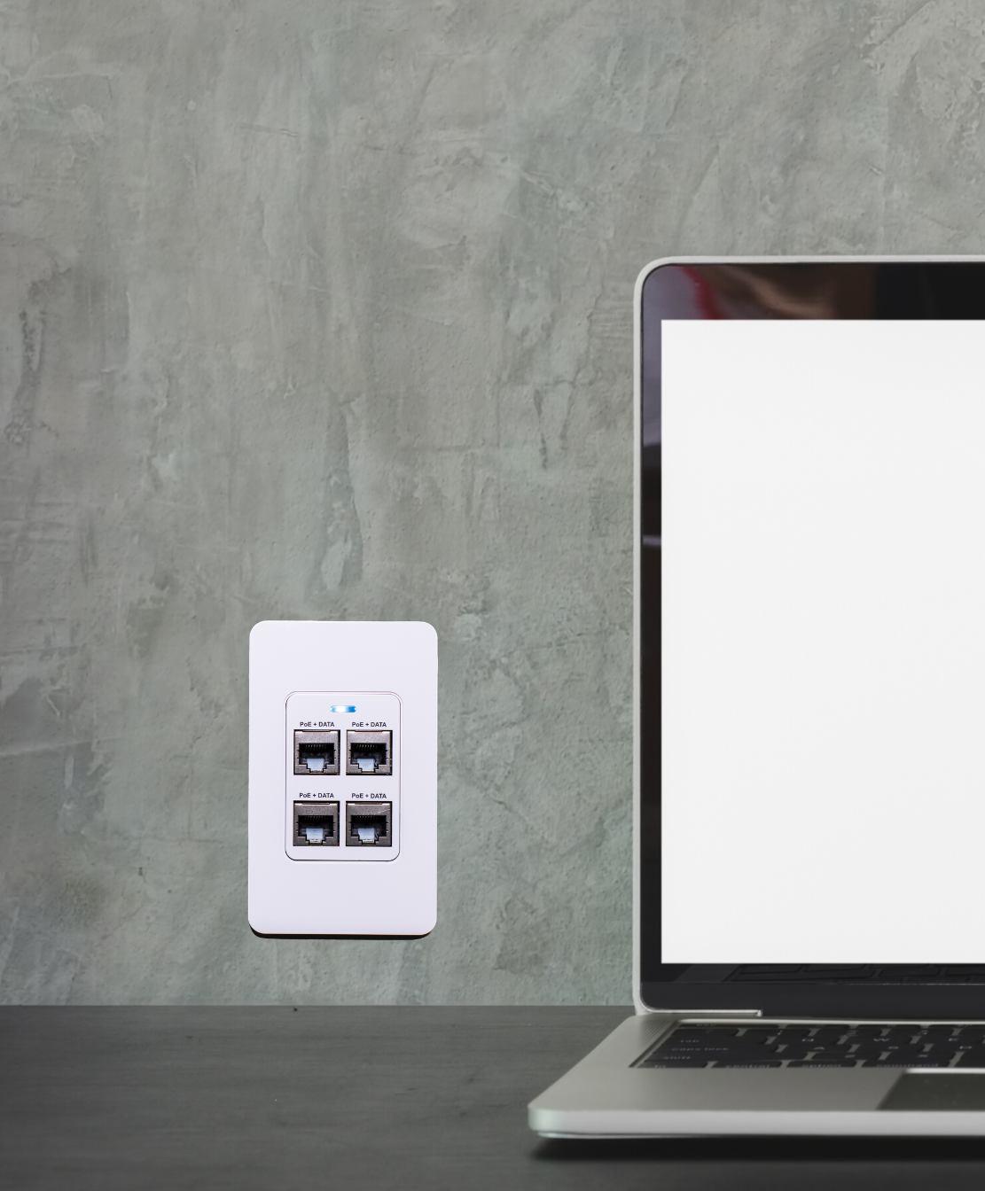
4 Port PoE - 1 Drop
Miniature In-wall Switch
IEEE 802.3bt - 72 watts
PoE+ Port
Gigabit Thru Put
VLAN Forwarding
Fits US Wall Boxes
Add Ports When You Can't Pull More Cables
GBT-4-IW
Launched in 2019

Slide 10
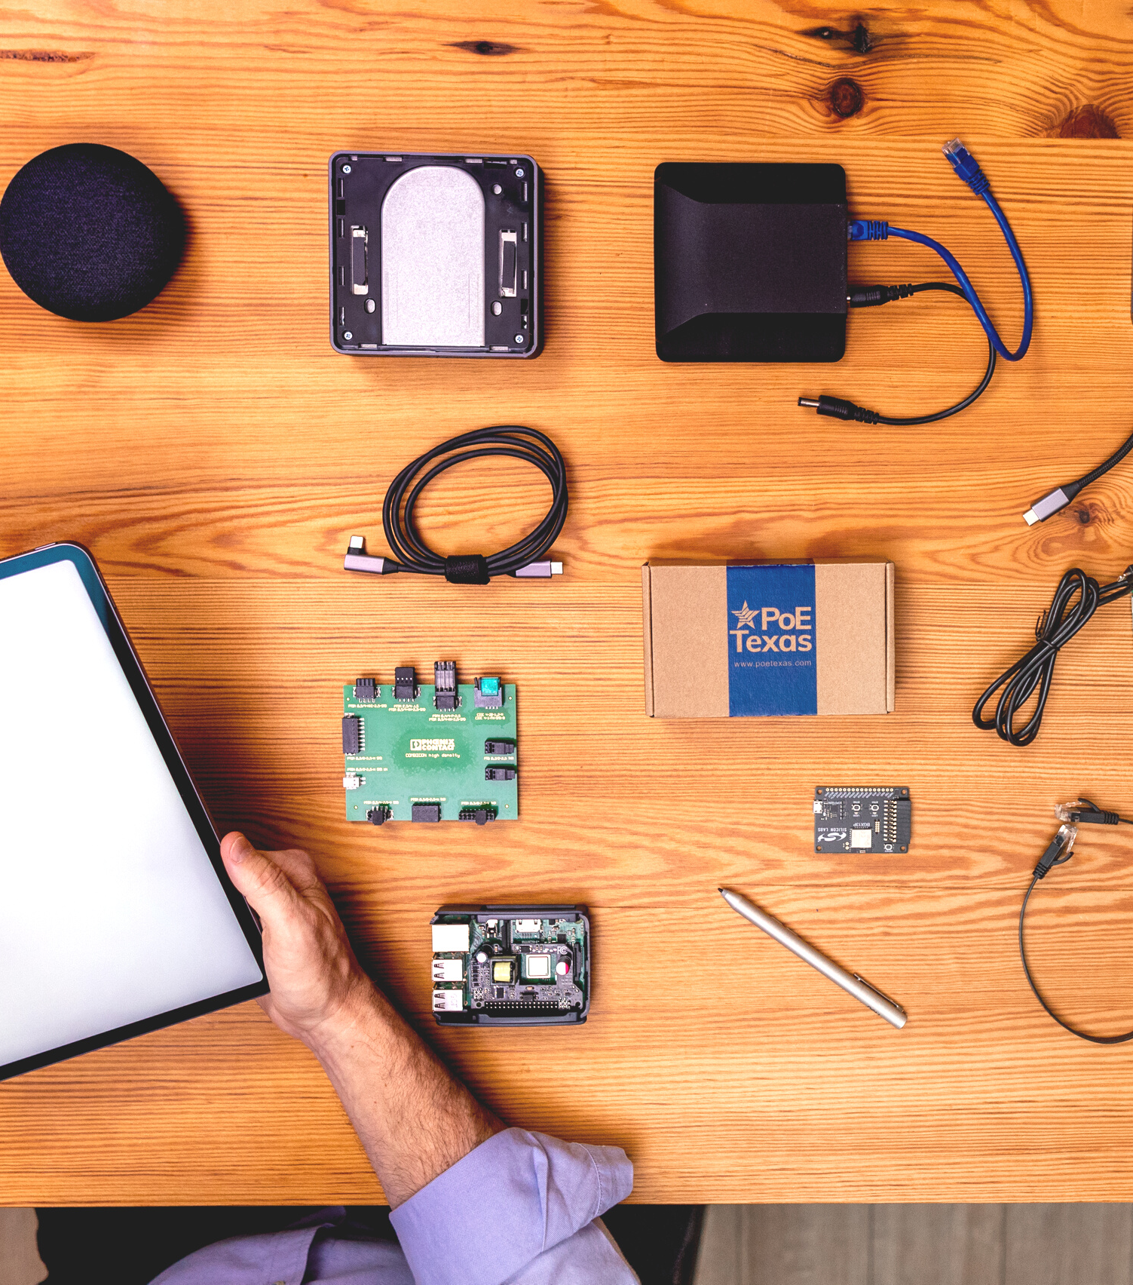
PoE - Edge Processors
PoE for Intel NUC
GBT-NUC
PoE for Raspberry Pi 3B+ and 4
GBT-NUC
Launched in 2019

Slide 11
Wrap Up
Take Advantage of the New IEEE 802.3bt and PoE standards to drive more business cost effectively
www.poetexas.com/technical-center/
success@poetexas.com
Are you ready to really expand your business? Join our sessions on PoE lighting and automation

